Slide 1

LAB MEETING
바이오메디컬공학부
201715447
김준형

Slide 2
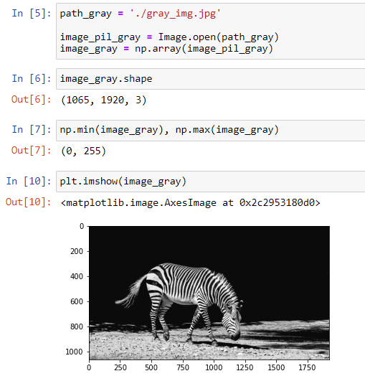
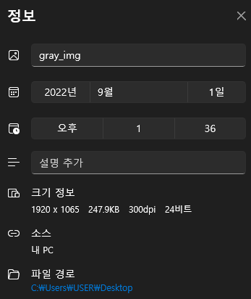
● 1. gray-scale image / color image

Slide 3
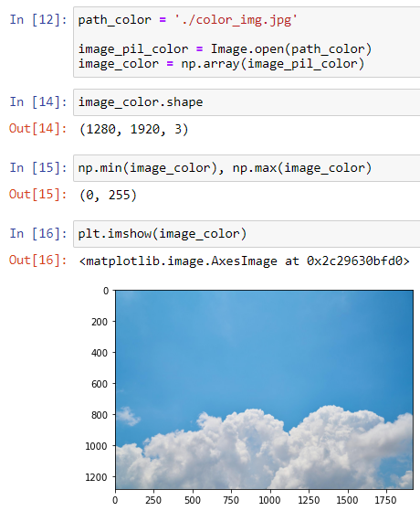
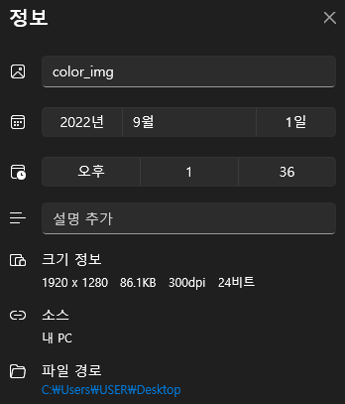
● 1. gray-scale image / color image

Slide 4
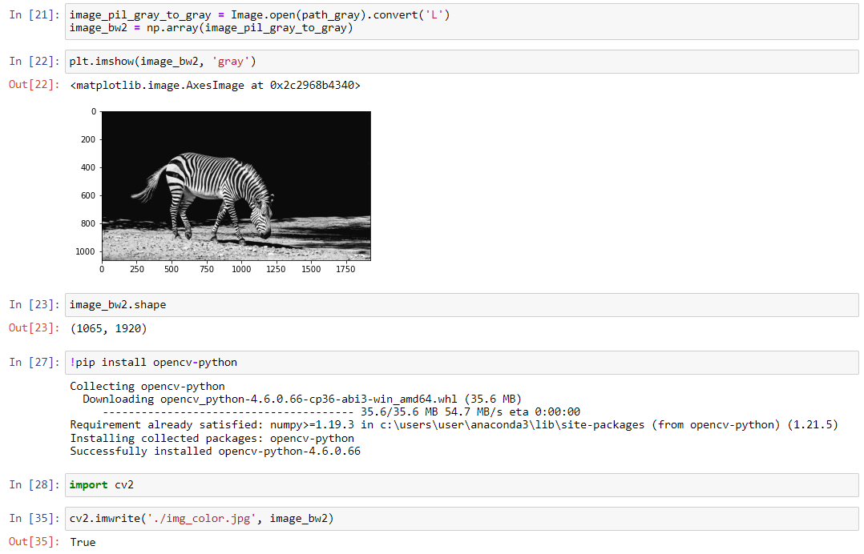
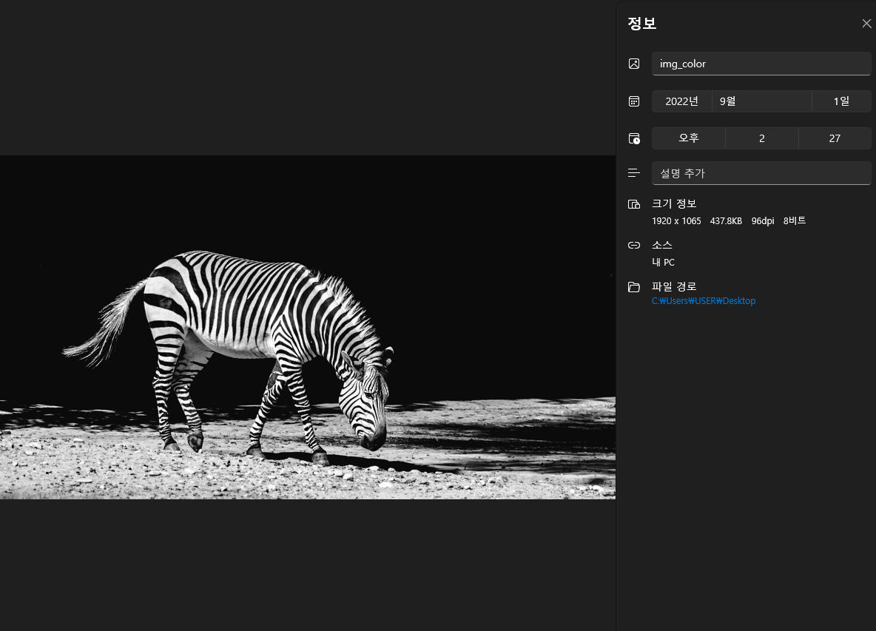
● 1. gray-scale image / color image

Slide 5
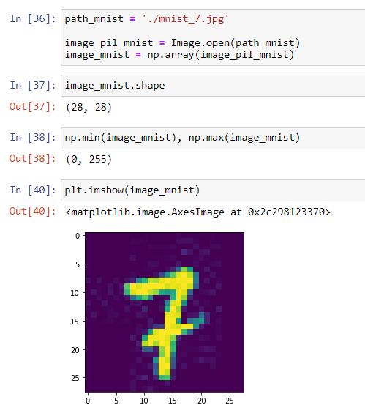
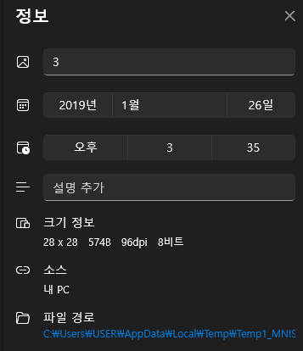
● 2. mnist datasets

Slide 6
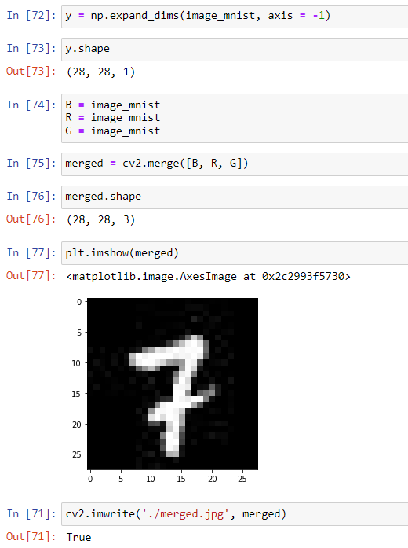
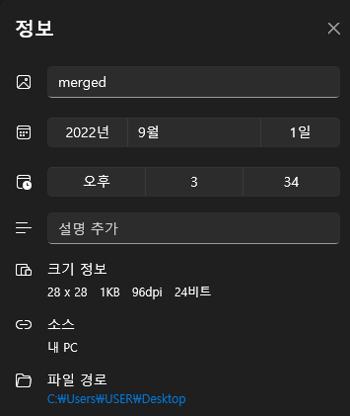
● 2. mnist datasets

Slide 7
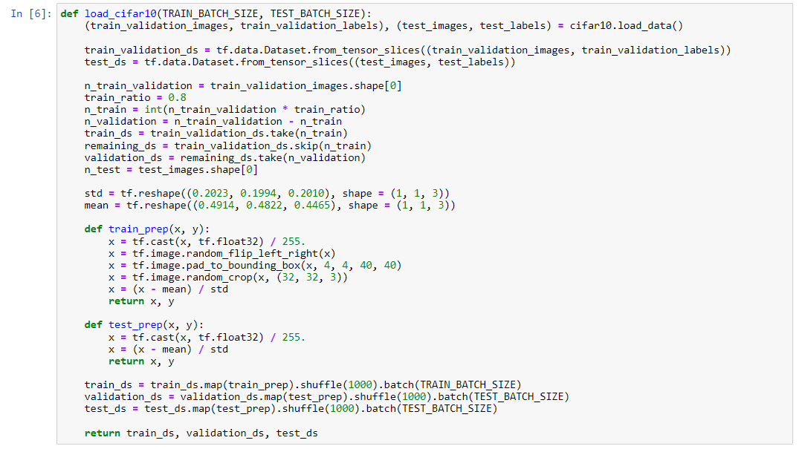
● 3. ResNet with Tensorflow & Keras

Slide 8
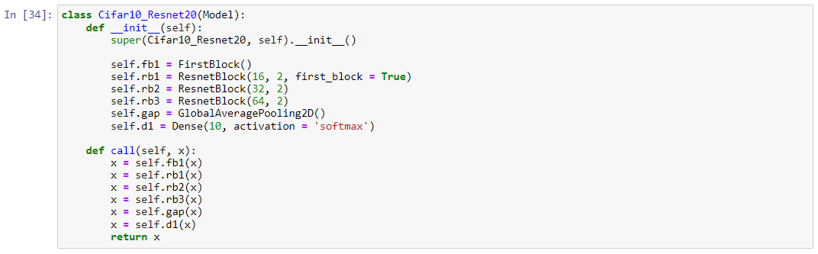
● 3. ResNet with Tensorflow & Keras

Slide 9
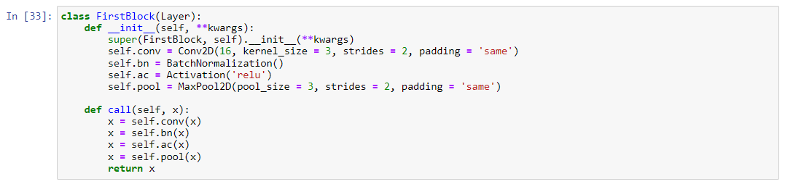
● 3. ResNet with Tensorflow & Keras

Slide 10
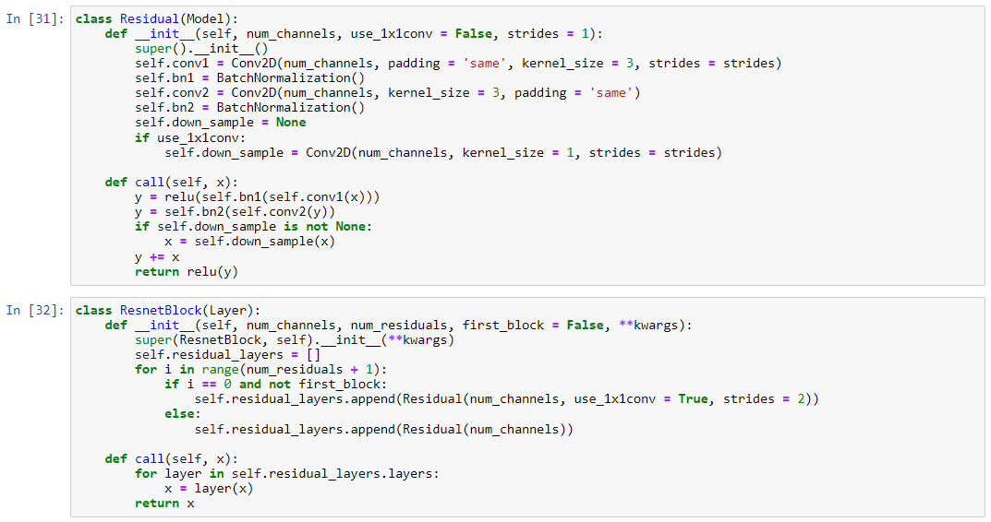
● 3. ResNet with Tensorflow & Keras

Slide 11
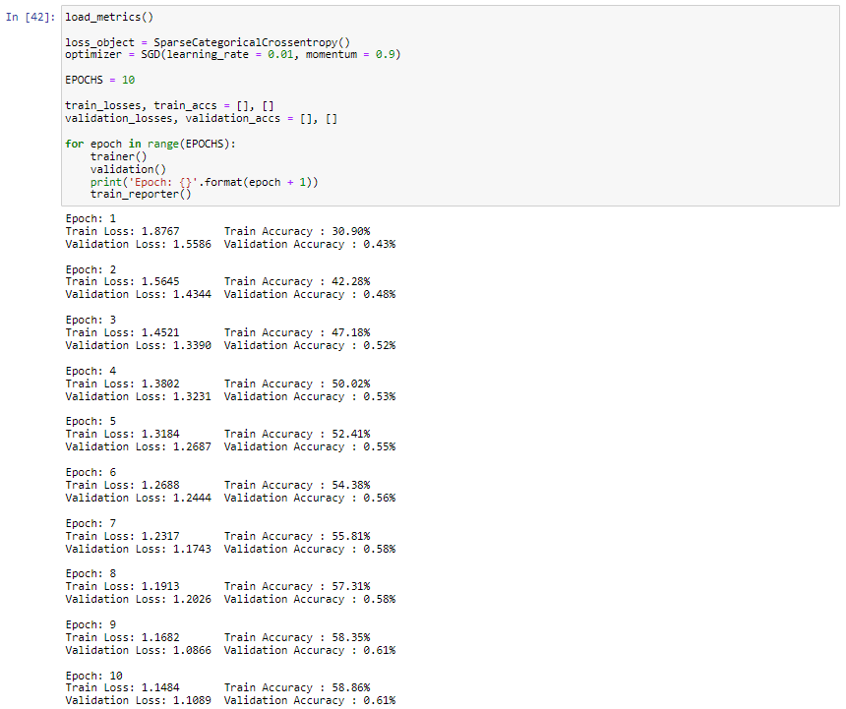
● 3. ResNet with Tensorflow & Keras

Slide 12
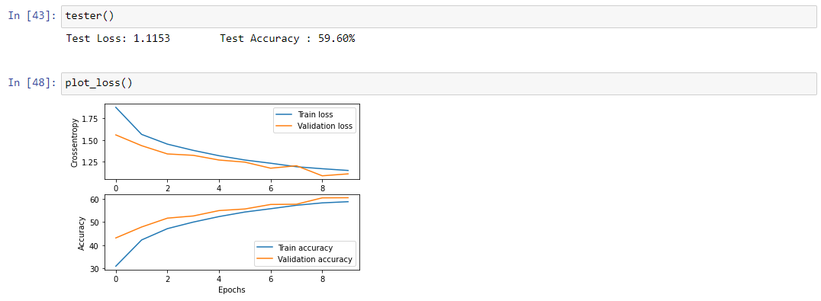
● 3. ResNet with Tensorflow & Keras

